Slide 1
Natural disasters
Top 4 Natural Disasters from 2004 to 2015 that were affecting Conoco Philips Oil Refineries in the USA

Slide 2
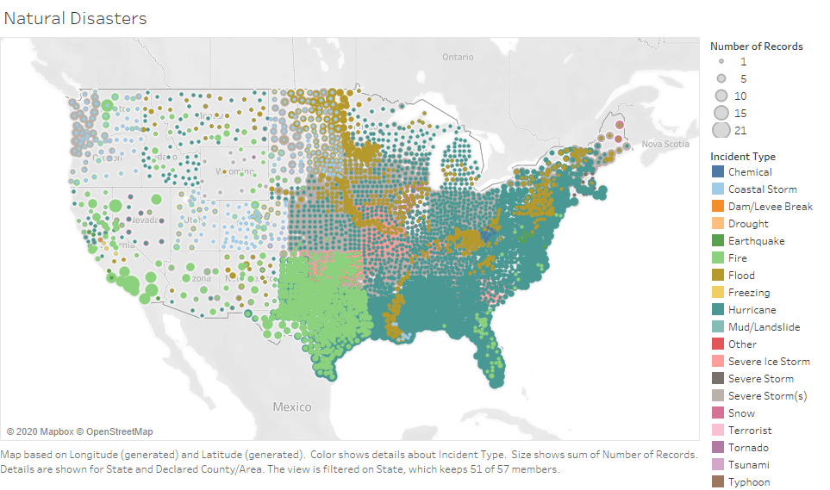

Slide 3
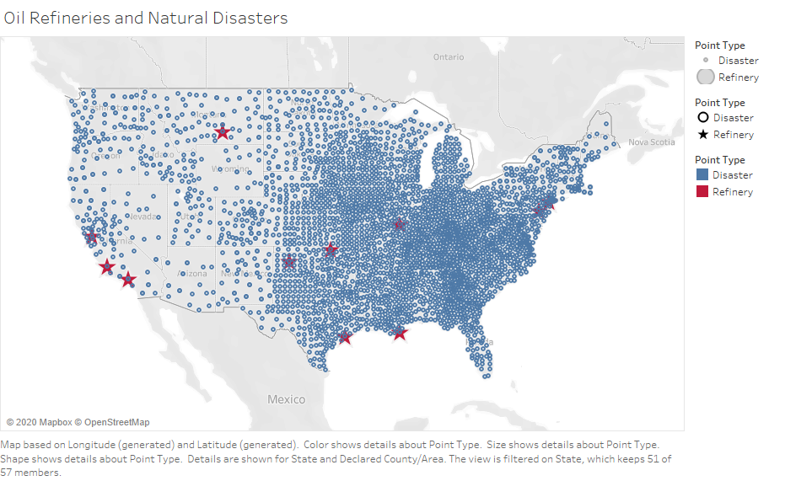

Slide 4
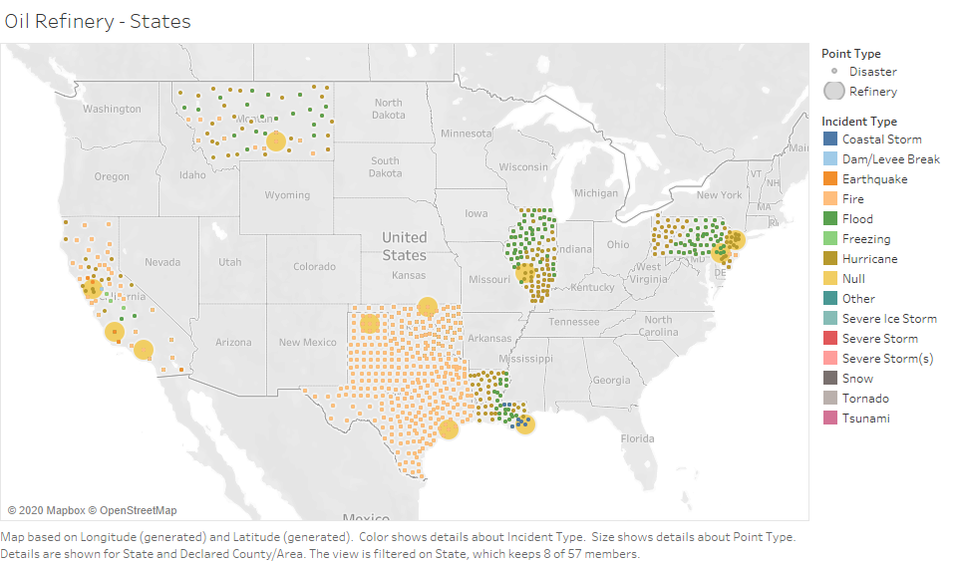

Slide 5
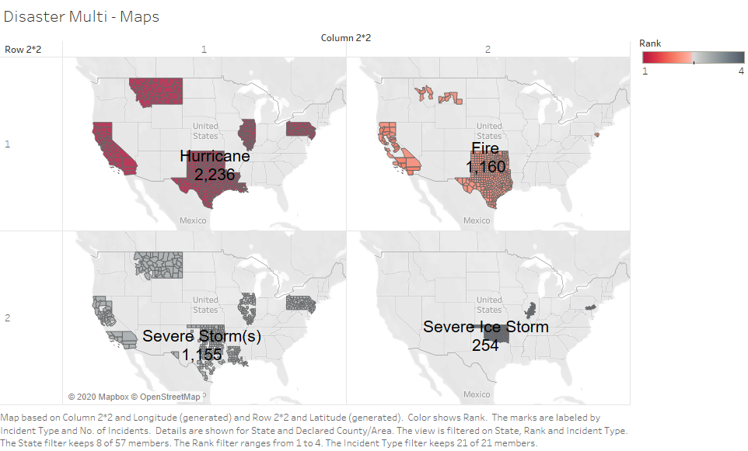

Slide 6
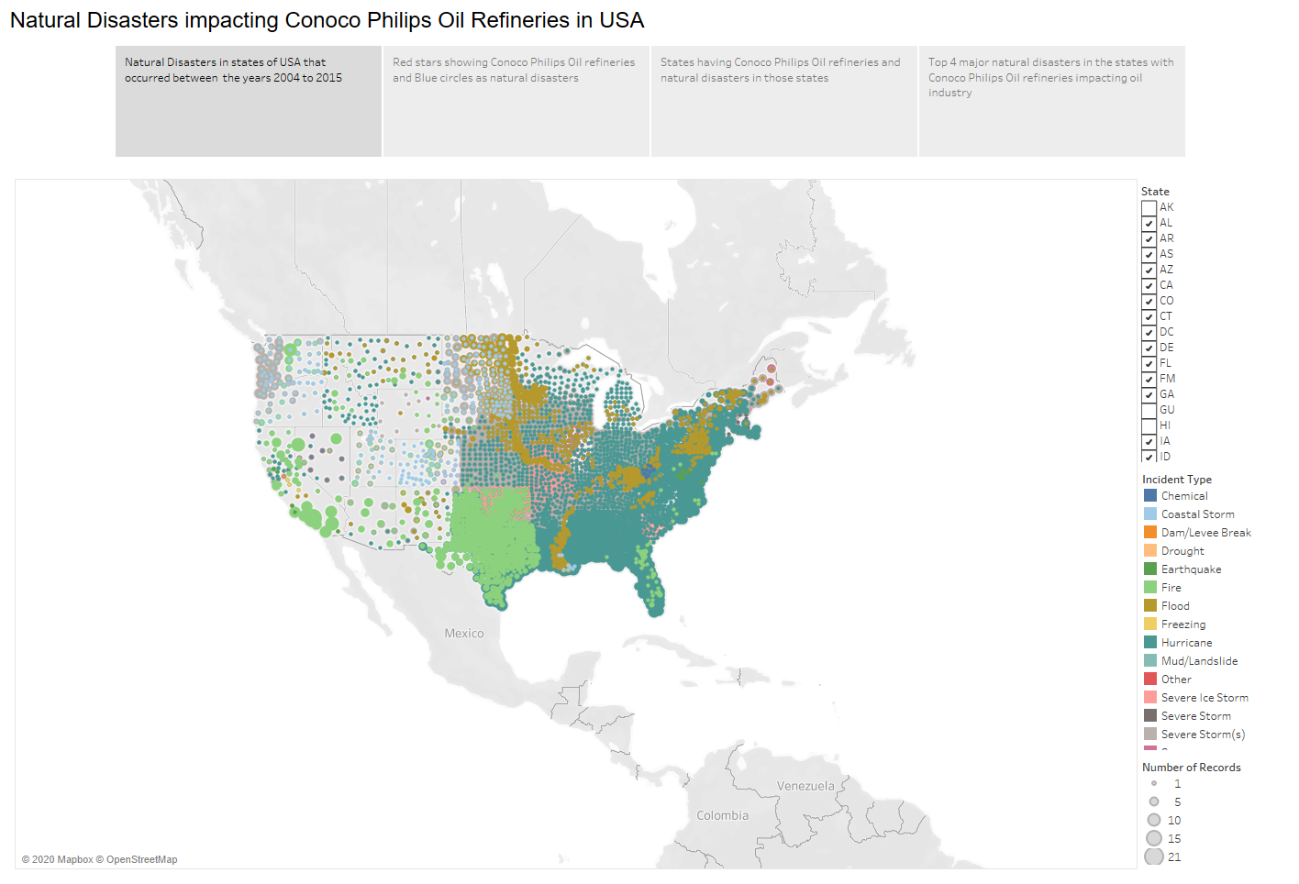

Slide 7
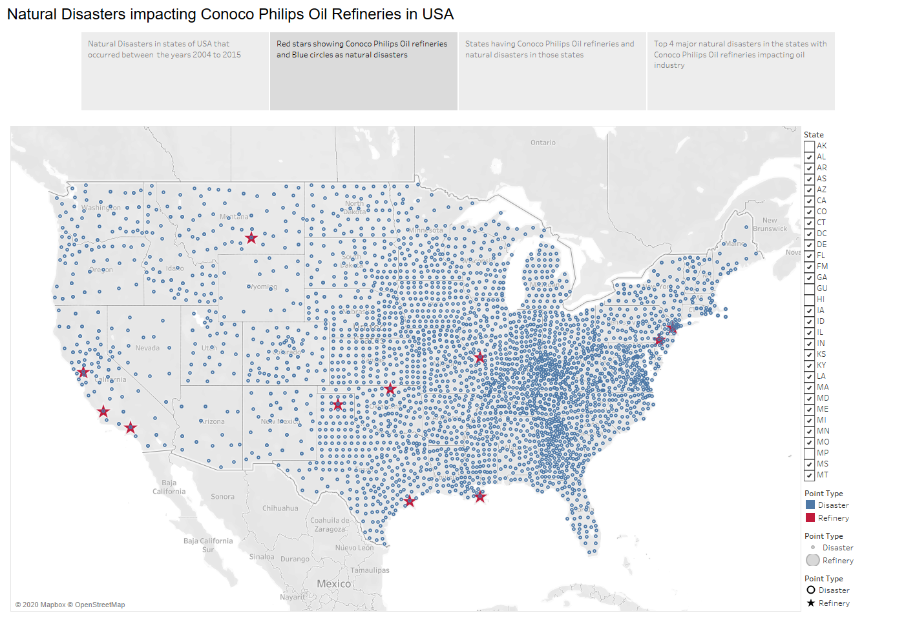

Slide 8
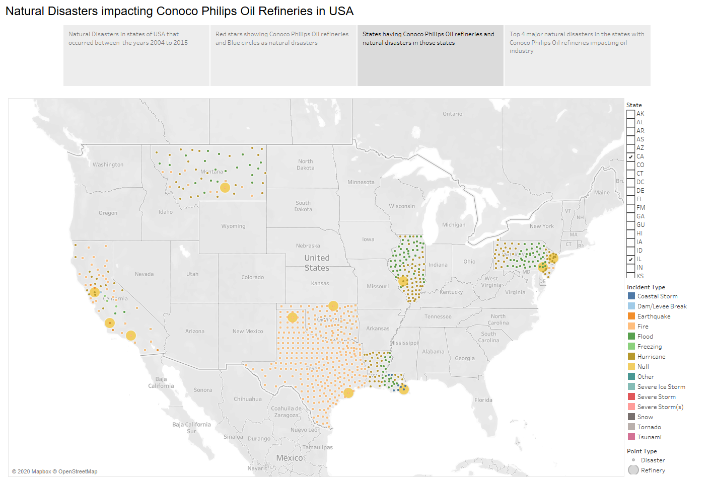

Slide 9
